Slide 1
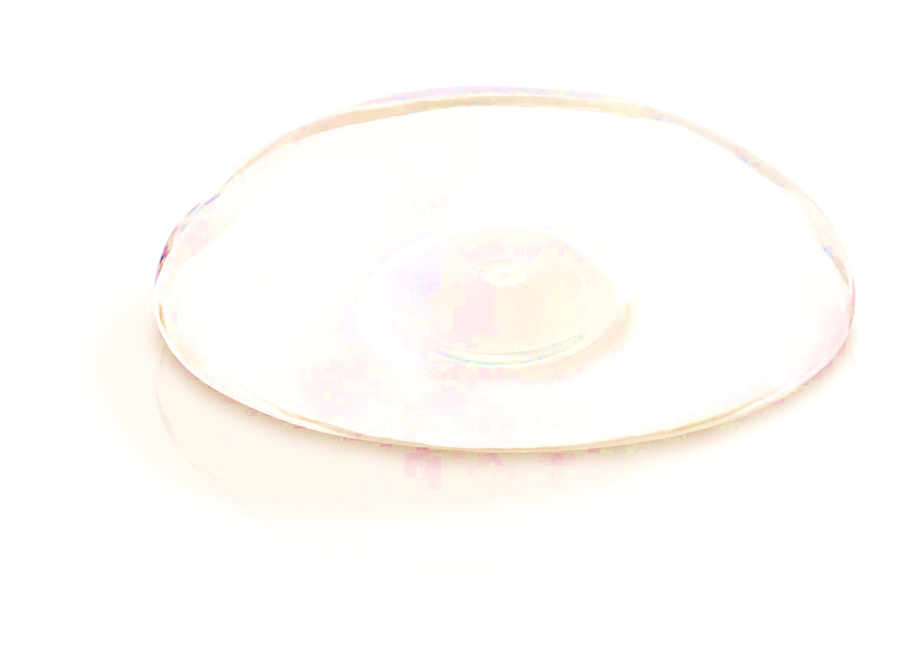
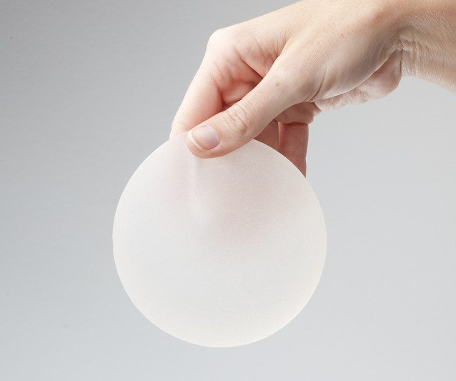

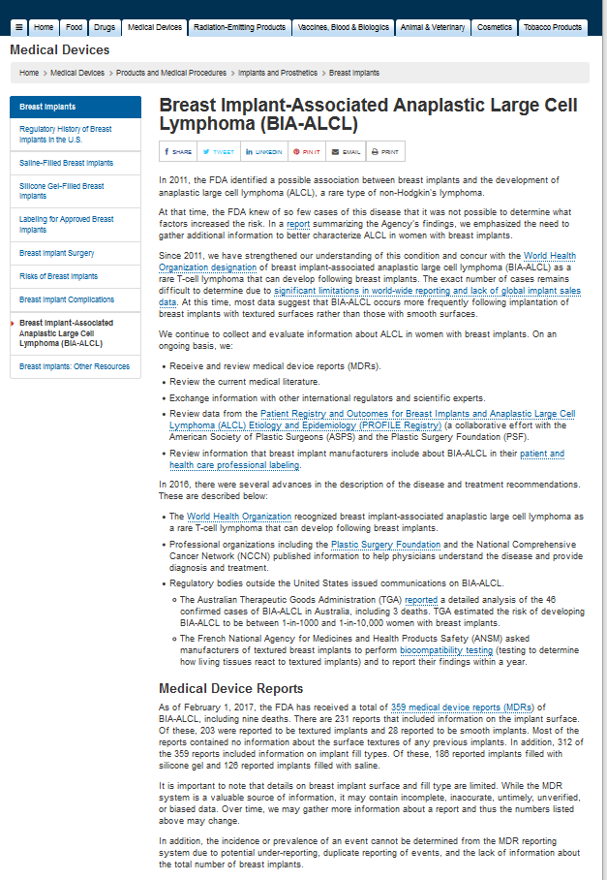
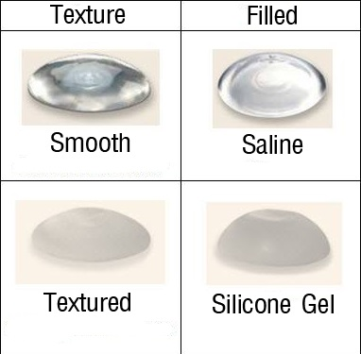
# 0
Building a Comprehensive Breast Implant Ontology Leveraging GUDID and Unstructured Data Sources
Mark Jung¹, Michael Wu², Hongying (Helen) Jiang³, Yu (Asiyah) Lin³, Weiguang Wang³, Zhou Feng³, Dongyi (Tony) Du³, Nilsa Loyo-Berrios³
BACKGROUND
¹Montgomery Blair High School, ²Wheaton High School, ³FDA/CDRH/Office of Surveillance and Biometrics
Individuals with breast implants have a risk of developing breast implant-associated anaplastic large cell lymphoma (BIA-ALCL), which appears to be highly associated with breast implants that have textured surface from the literature. However, both device FDA product codes and Global Medical Device Nomenclature (GMDN) do not provide the terms for breast implants surface type. This significantly hinders the data analysis of the association between the breast implant types and BIA-ALCL. A Breast Implant Ontology can categorize all the breast implant products and their features/attributes under an ontological structure, which can be used by a semantic reasoner tool to automatically classify breast implants features (e.g. smooth or textured surface types). This ontology will also be used as a backend dictionary for a text mining tool to help explore the patterns/trends from BIA-ALCL cases reported in the MDR or other data sources.
Generating the Ontology Sections through Python
CONCLUSIONS AND DISCUSSIONS
Python libraries — including NumPy and Pandas – were used for piping data through text-capture filters into the Pandas DataFrame data structure and finally into an Excel file. This will be automated as much as possible to facilitate future GUDID downloads. Protégé, an open source ontology application, was used to help categorize each implant based on their properties to create a logical structure. To increase efficiency, the Python Owlready2 library was used to load all content from the excel sheets into the ontology.
FDA Actions – website update and communications
On 3/23/2017, FDA updated the ALCL website:
Updated analysis on received ALCL cases from MDRs and literature
RESULTS
Distribution of Major Device Characteristics
Fill types: 35% Saline vs. 52% Silicone in MDRs, and 44% Saline vs. 56% Silicone in literature.
Surface types: textured surface was much more frequent than smooth surface (90% vs 1% in literature, and 57% vs 8% in MDR).
OBJECTIVE
The objective of our project is to create an extensive ontology to categorize the different breast implants and their product features, including but not limited to: manufacturer, brand, filling, and so on. The ontology will help FDA determine possible relationships between BI structures and patient symptoms that correspond with BIA-ALCL.
Figure 2. Major device characteristics from ALCL reported from literature and from MDRs
METHODS
Breast implant data on implant characteristics were gathered primarily from the GUDID database using the FDA product codes FWM and FTR. Current catalogs from four breast implant sponsors were also used for cross-verification of data as well as providing additional information, such as device dimensions, diameters, heights, projection, etc. Free text such as literature review and research articles were also included.
Biomarkers, Clinical Presentation and Treatments
MDR data Limitations
While the MDR system is a valuable source of information, this passive surveillance system has limitations, including incomplete, inaccurate, untimely, unverified, or biased data in the reports. In addition, the incidence or prevalence of an event cannot be determined from this reporting system alone due to potential under-reporting, duplicate reporting of events, and the lack of information about the total number of breast implants.
CD30: 100% positive in MDRs and 100% positive in literature
ALK: 100% negative in MDRs; 95% negative and 5% (2 cases) positive in literature.
Presentation changes to breast tissue: mostly seroma, mass, capsular contracture, others … (Fig.3)
Treatments: explant/capsulectomy, single or combined chemo/radiation therapies
RESULTS
This project is supported by FDA/CDRH OSB lab research module. Authors want to acknowledge the valuable support from DEPI and DSD teams, particularly Danica Marinac-Dabic, Binita S Ashar, Reza Miraliakbari, Dongyi (Tony) Du, and Erica Zeno.
Figure 3. Reported presentations in breasts
(MDR data)

